Slide 1


Forecasting Monthly Restaurant Sales
This project forecasts the next 6 months of restaurant sales.
The goal is to improve inventory, staffing, and promotions.
by Sumanth H

Slide 2

Why Forecasting Sales?
Avoid Stock Issues
Optimize Staffing
Prevent understocking and overstocking to reduce waste and costs.
Adjust staff schedules with sales trends to improve efficiency.
Plan Revenue
Use forecasts to align budgets and marketing promotions.

Slide 3
Data Cleaning & Preprocessing
Data Handling
Resampling & Visualization
Imported sales CSV file
Set date as index
Converted date to datetime format
Resampled data to monthly frequency
Checked for null values and outliers
Explored trend and seasonality visually

Slide 4

Understanding Time Series Components
Residual
Trend
Random noise and irregular fluctuations in data.
Long-term increase or decrease in sales volume.
1
2
3
4
Seasonality
ACF & PACF
Recurring patterns that repeat at regular intervals.
Used for selecting model lag parameters effectively.

Slide 5
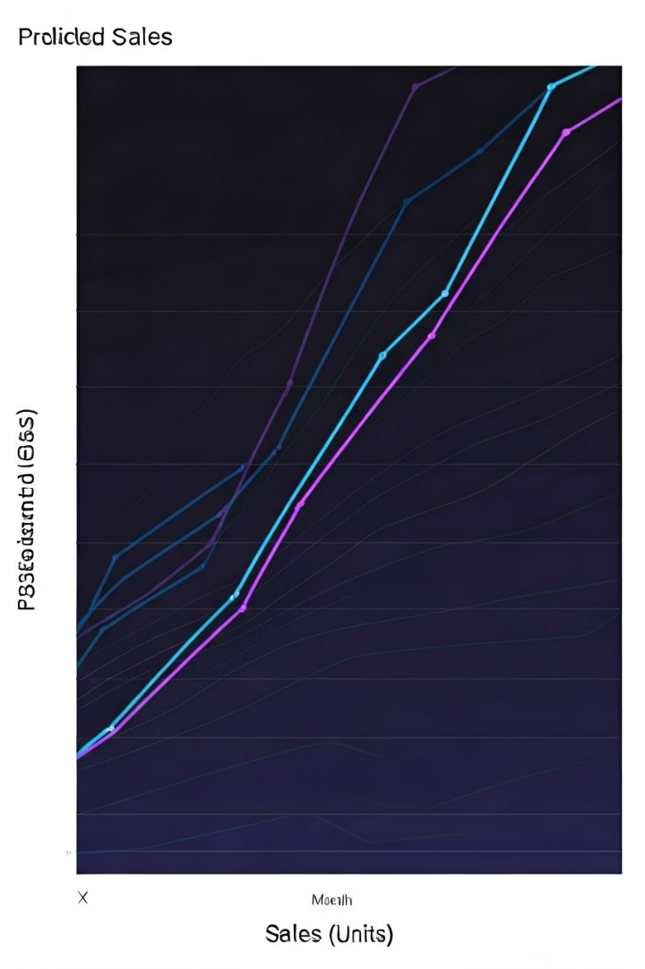
Forecasting with ARIMA
Model Selection
Determined ARIMA parameters p, d, q using ACF and PACF plots.
Training
Fitted the model on historical monthly sales data.
Evaluation
Assessed error metrics: RMSE and MAE for accuracy.

Slide 6
Predicted Monthly Sales (Next 6 Months)
Forecast Output
Insights
Future sales in tabular and chart form
Stable growth predicted
Seasonal patterns well captured
Confidence intervals support reliability

Slide 7

Insights from Forecast
Inventory Allocation
Stock up more during peak sales months to avoid shortages.
Labor Optimization
Adjust staffing levels to meet expected customer flow efficiently.
Promotional Planning
Run offers in low sales months to boost demand strategically.
Model Maintenance
Update forecasts regularly with fresh data for accuracy.

